Slide 1
Study Skills

Slide 2
BLOCK off UNDISTRACTED time
BLOCK
Set a schedule and stick to it!
Work when you’re “on fire”
Treat this like a part-time job
UNDISTRACTED
Our brains are terrible multi-taskers!
Focus cements concepts
Avoid frequent interruptions
Family
Pets
Social media
Texts
Your worried brain

Slide 3

Willpower is a Muscle to Build
18+ days to form a habit
Delayed gratification = improved success
Start small, be consistent!
Celebrate the wins

Slide 4
Take Care of Yourself
Brains function better with…
Sleep
Protein
Time to unwind
Frequent breaks
Social support

Slide 5
What’s Important?
Don’t need to remember everything
Focus on big-picture concepts
Review the key terms at the end of the lesson and quizzes on each page to help guide you
Keep an eye out for repetition

Slide 6
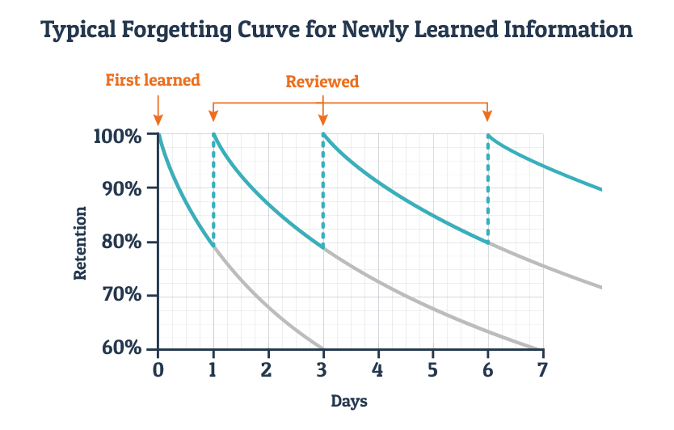
Huh? What was that?

Slide 7
Everyone Learns Differently
Reading
Writing
Listening
Doing – “Kinesthetic”
Watching videos

Slide 8
Retaining what You’ve Learned
Remember better if you:
Process more ways
Refresh more times
Explain it to someone else
Make connections to your life
Take notes! +50% to retention!

Slide 9
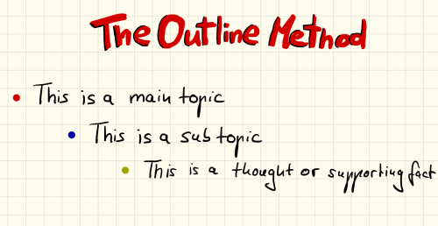
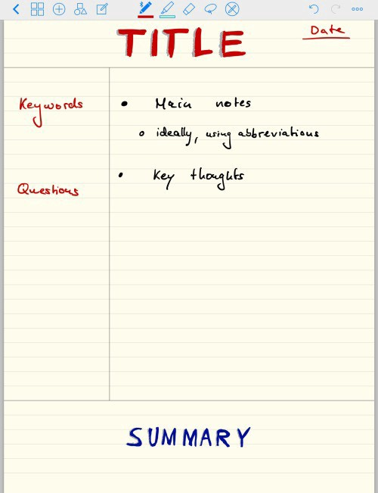
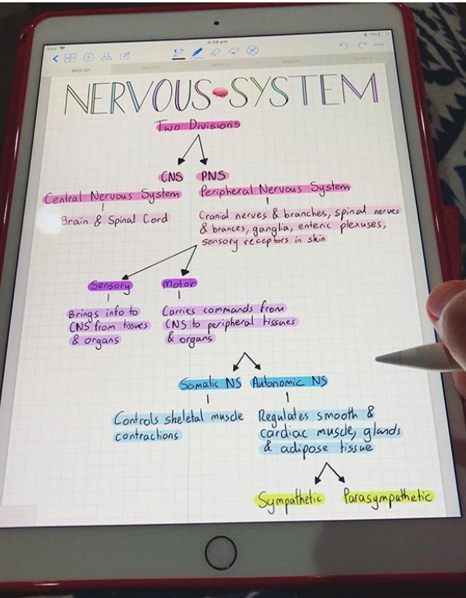
Note-taking Styles
Outline it!
Keep track of key terms and questions!
Map it out!

Slide 10
Note-taking Tips
Short and sweet
Summarize
Experiment until you find something that works

Slide 11
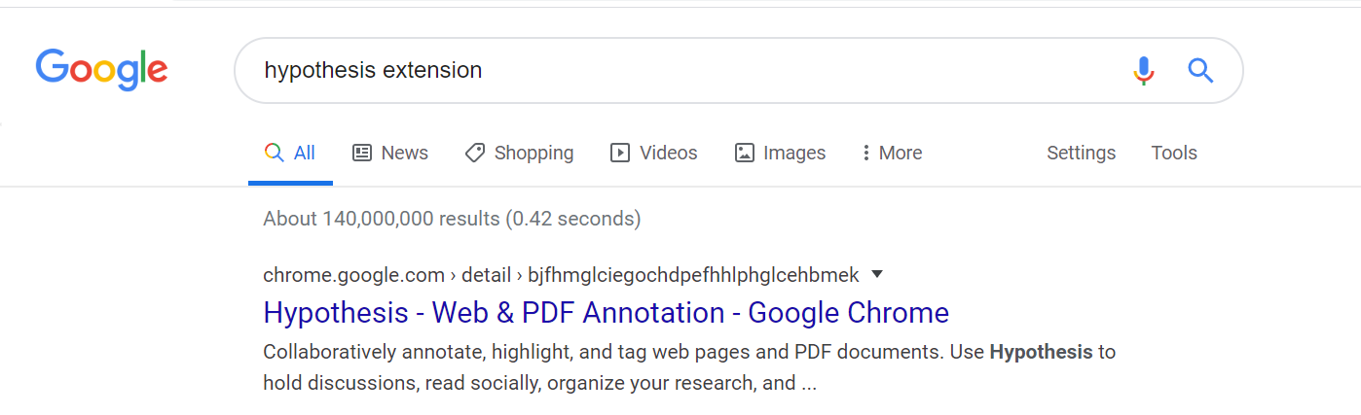
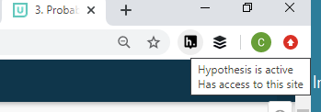
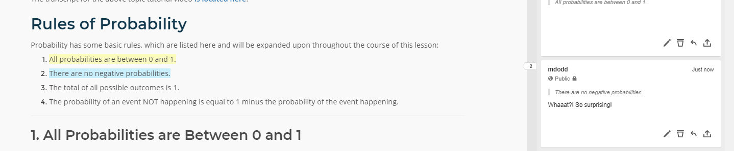
Chrome’s Extension - Hypothesis

Slide 12
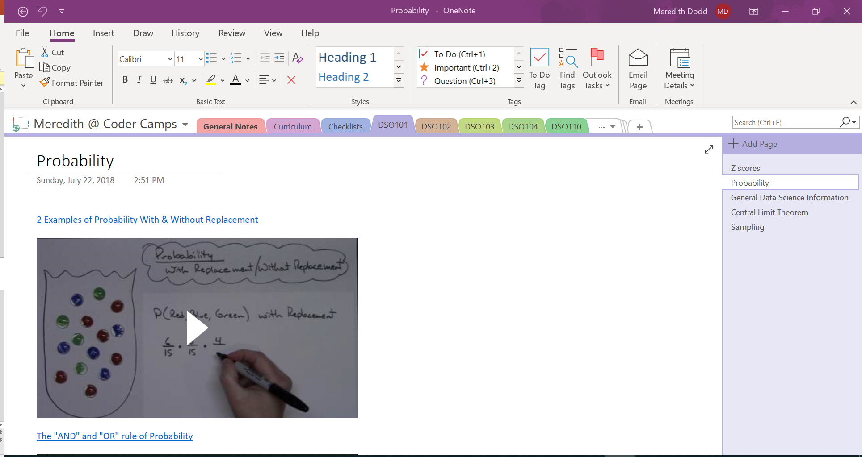
Copy your Classes to Search Later
Copy into a text document like MS Word or MS One Note
Ctrl + F (Windows) or Cmd + F (Mac) to find a keyword

Slide 13


Organize Your Files
Set up a file folder system so you always know where everything is!
Data Science Course
DSO101 Basic Statistics
Lesson 1 Introduction to Data Science
Lesson 2 Probability

Slide 14
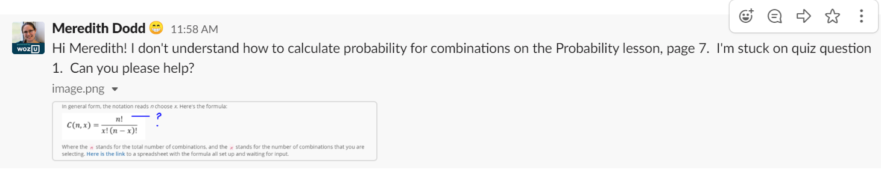
Help us Help you!
Include the following:
Module (DSO101)
Lesson Name/Number
Page Number
Quiz / Exam Question Number
Any details you can
Screenshots if needed

Slide 15
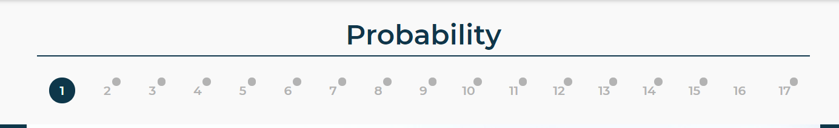
Where can I find that Info?
Lesson Name
Page Number

Slide 16
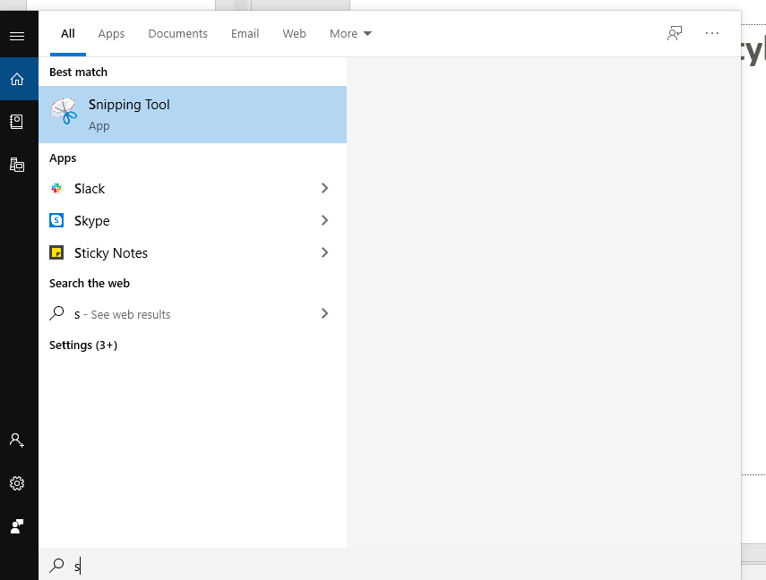
How do I take Screenshots?
Windows – Snipping Tool
Macs
Whole Screen: Cmd + Shift + 3
Part Screen: Cmd + Shift + 4

Slide 17
Question Away!
Work ahead before your 1on1 or office hour
Write all questions down
Nothing too small or silly!
Slack and we’ll always get back to you

Slide 18
Questions?

